Slide 1
Mini Project Report On
Banking Simulation System

Slide 2
Submitted By:
Under the guidance of :
Prof. Uma Pujeri ma’am
NAME | PRN
Shivam Ramesh Lamkhade | 1262252900
Jaideep Kalekudhiti | 1262253233
Arun Mishra | 1262251280
Shubham Kumar Himanshu | 1262253979
Sujal Shriramjwar | 1262253844

Slide 3
Table Of Contents
Sr. No. | Title | Page No.
1. | Abstract | 5.
2. | Introduction | 6.
3. | Problem Statement | 7.
4. | Objectives | 8.
5. | Technologies Used | 9.
6. | System Design | 10.

Slide 4
7. | Key Features | 11.
8. | C Programing Concepts Used | 13.
9. | Advantages | 14.
10. | Limitations | 15.
11. | Future Enhancements | 16.
12. | Screenshots Of Output | 17.
13. | Conclusions | 21.

Slide 5
Abstract
This project presents a Banking Simulation System developed using the C programming language. The system simulates real-world banking operations such as account creation, secure login, deposits, withdrawals, loan processing, mutual fund investments, and transaction history management. The application is menu-driven and designed using structured programming concepts. Basic PIN encryption using XOR technique ensures account security.

Slide 6
Introduction
The Banking Simulation System is a console-based application that mimics the working of a real banking environment. It allows users to create accounts, log in securely, and perform various banking operations through an interactive menu system.
The system also provides financial services such as loans and mutual fund investments, making it a complete simulation of core banking features.

Slide 7
Problem Statement
Manual banking systems are time-consuming and prone to errors. There is a need for a digital system that can:
Manage multiple accounts
Secure user credentials
Track financial transactions
Provide loan and investment services
Allow administrative monitoring
This project aims to simulate such a banking system using C programming.

Slide 8
Objectives
To simulate real-world banking operations
To implement secure PIN authentication
To manage deposits and withdrawals
To implement loan calculation and repayment
To provide mutual fund investment options
To maintain transaction history

Slide 9
Technologies Used
Programming Language: C
Libraries Used:
stdio.h
stdlib.h
string.h
windows.h

Slide 10
System Design
The system uses a structure named Account to store:
Account number
Customer name
Encrypted PIN
Balance
Loan details
Mutual fund investment
Transaction history
The program is modular and divided into multiple functions for better organization.

Slide 11
Key Features
1. Account Creation
Users can create a new account with account number, name, and PIN.
2. Secure Login
PIN is encrypted using XOR operation for basic security.
3. Deposit
Users can deposit money into their account.
4. Withdraw
Users can withdraw money with balance validation.
5. Loan Services
Apply loan with interest calculation
Repay loan

Slide 12
6. Mutual Fund Investment
Low Risk (6%)
Medium Risk (10%)
High Risk (15%)
Withdraw investment
7. Transaction History
All transactions are recorded and displayed when requested.
8. Admin Dashboard
Admin can view total accounts and account details.

Slide 13
C Programming Concepts Used
Structures
Arrays
2D Arrays
Functions
Loops
Conditional Statements
String Handling
XOR Encryption
Menu-driven Programming

Slide 14
Advantages
Simple and user-friendly
Secure PIN handling
Tracks transaction history
Includes loan and investment features
Demonstrates practical C programming

Slide 15
Limitations
Data is not permanently stored
Basic encryption only
Console-based interface
Limited maximum accounts

Slide 16
Future Enhancements
Add file handling for permanent storage
Implement advanced encryption
Develop GUI version
Add account deletion and update options

Slide 17
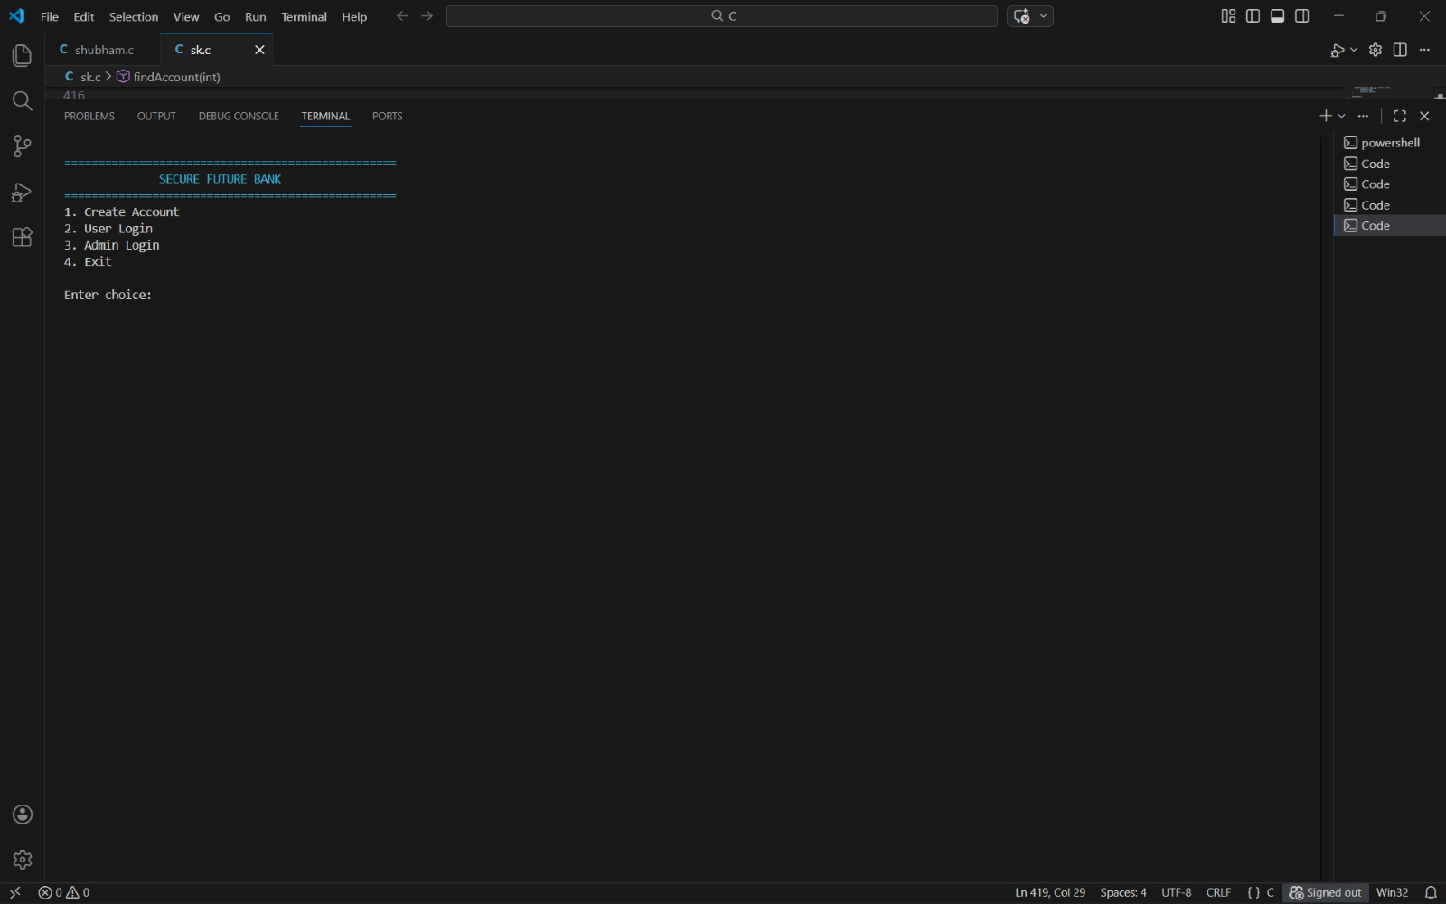
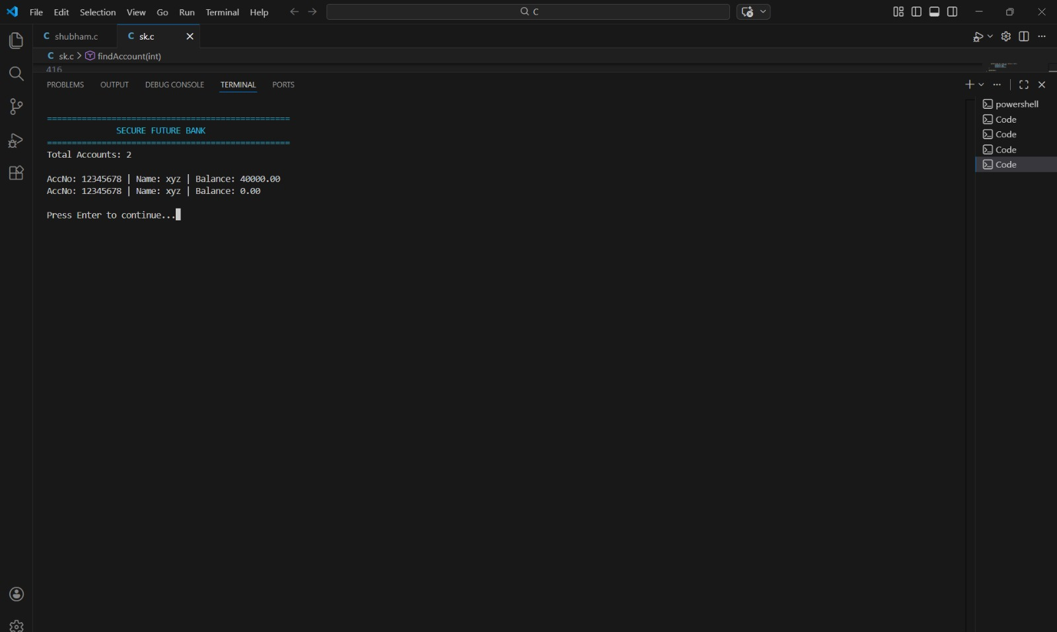
Screenshots Of Output

Slide 18
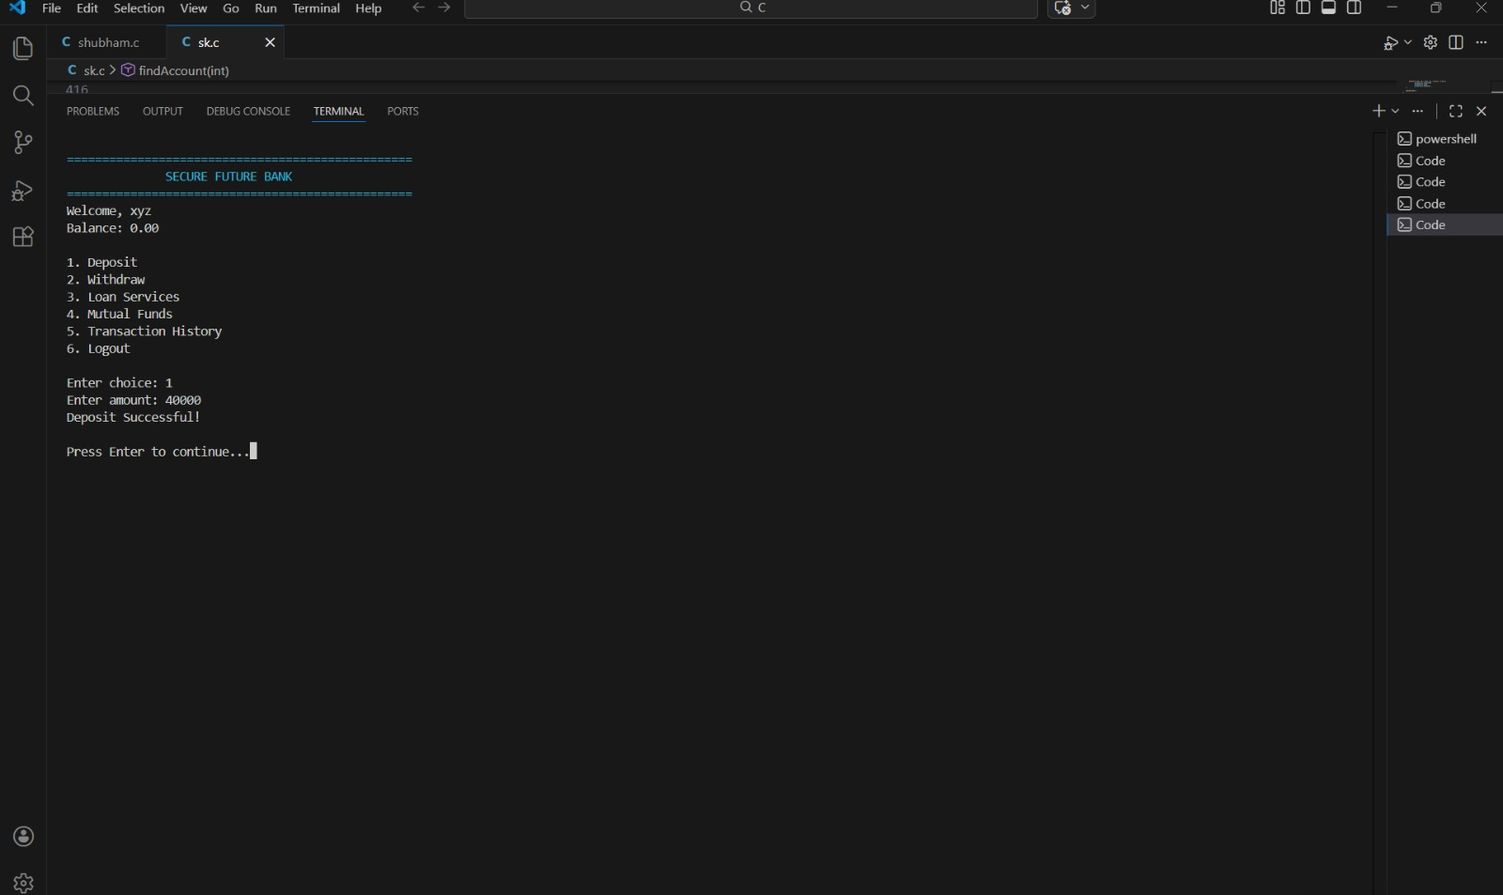
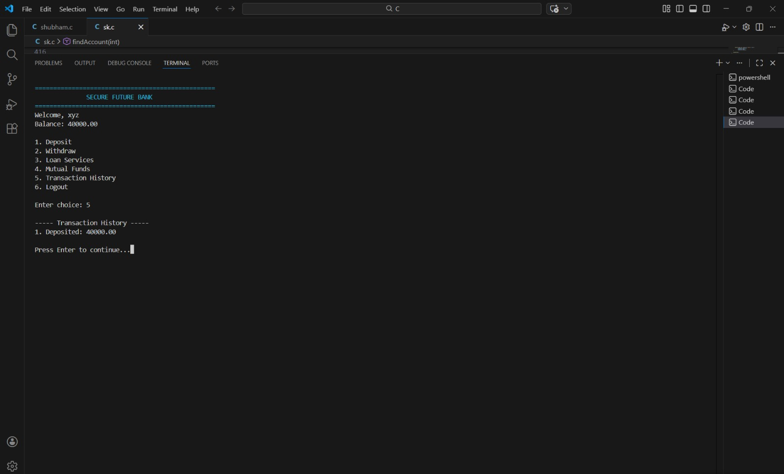

Slide 19
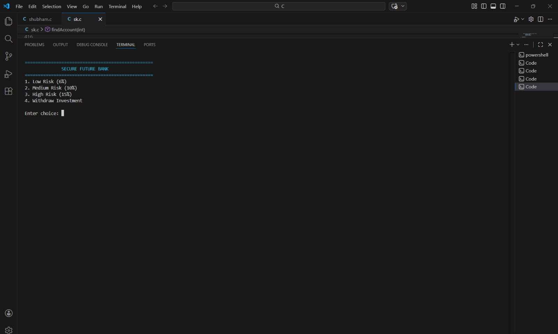
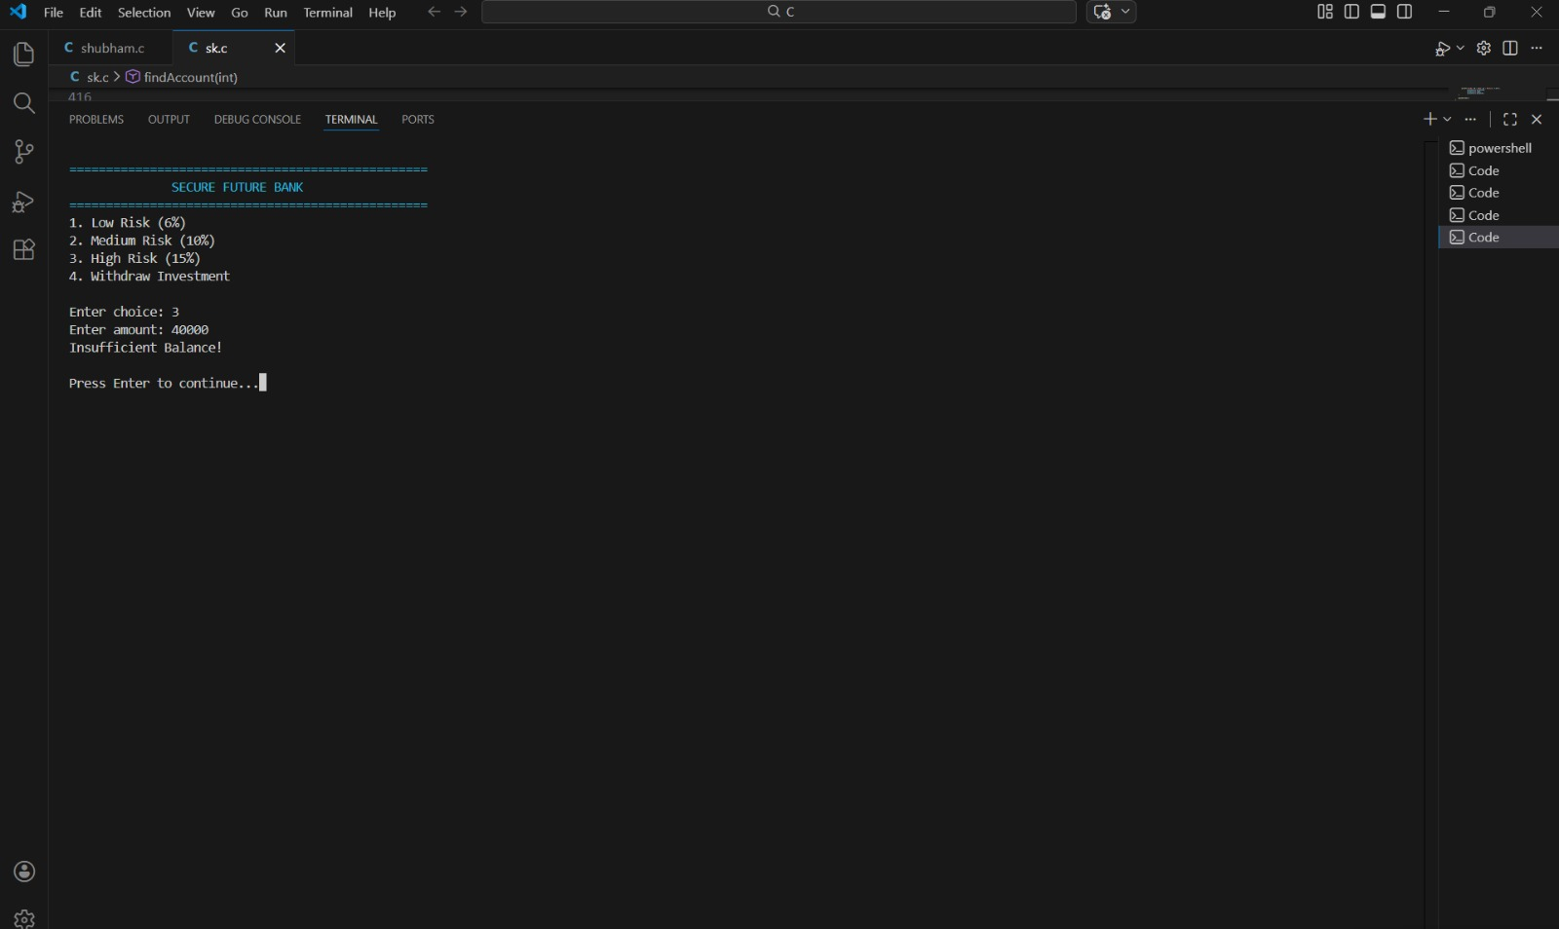

Slide 20
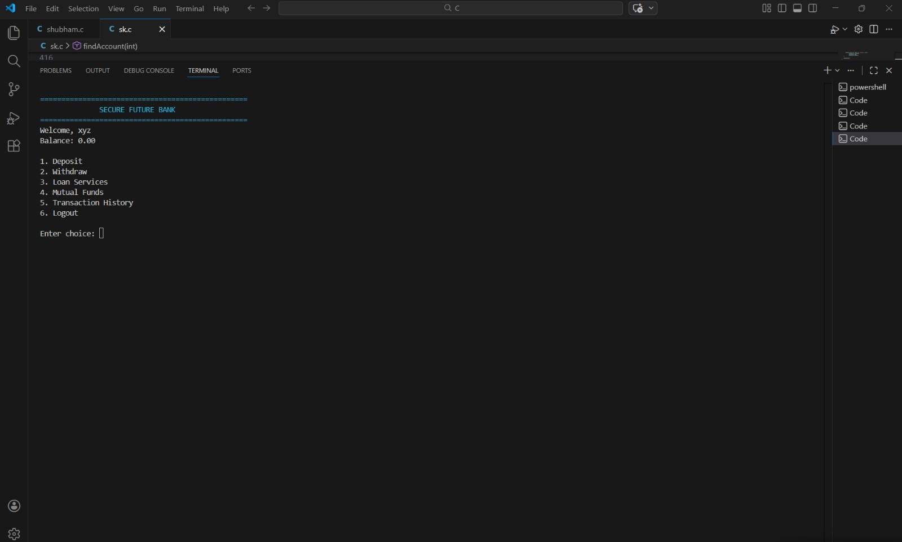
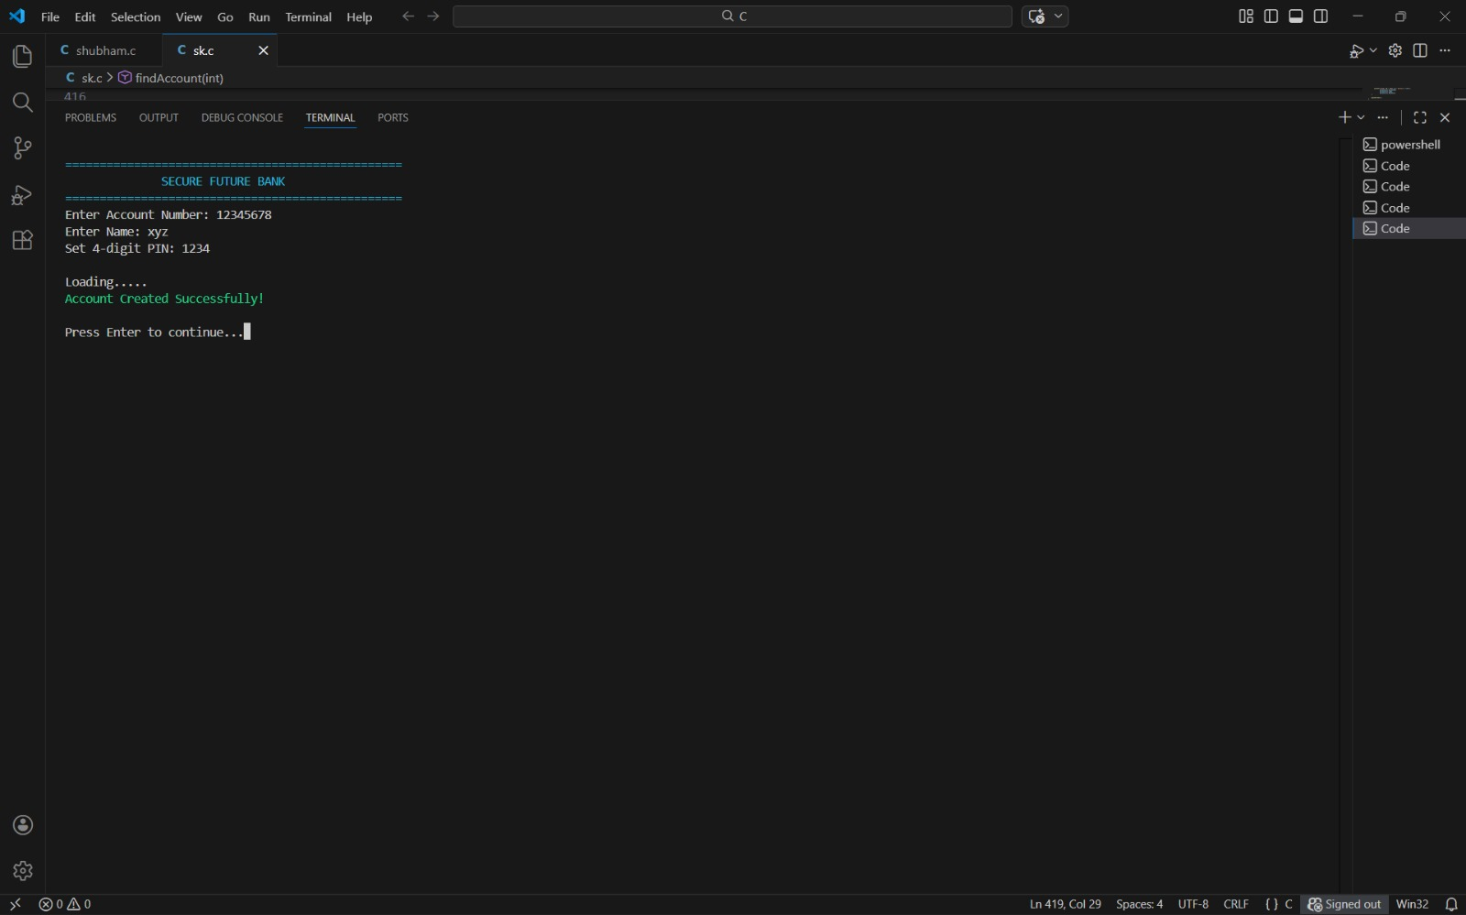

Slide 21
Conclusion
The Banking Simulation System successfully demonstrates the practical implementation of C programming concepts in building a functional banking model. It integrates security, financial calculations, and transaction management into a structured and organized program. This project provides a strong foundation for understanding real-world banking software logic.

Slide 22
Thank You !!

